Slide 1
EMOTION AI
KAGGLE AND UDEMY

Slide 2
PROJECT OVERVIEW
PART-01
KEY FACIAL POINTS DETECTION
IN PART 01, WE WILL CREATE A DEEP LEARNING MODEL BASED ON CNN AND RESBLOCK TO PREDICT FACIAL KEY-POINTS.
Data Source: https://www.kaggle.com/PART-01/
PART -02
IN PART 02, WE WILL CLASSIFY PEOPLE’S EMPTION.
HERE, DATA CONTAINS IMAGES THAT BELONG TO 5 CATEGORIES: 0 = ANGRY, 1 = DISGUST, 02 = SAD, 03 = HAPPY AND 04 = SURPRISE.
Data is source: https://www.kaggle.com/PART-02/

Slide 3
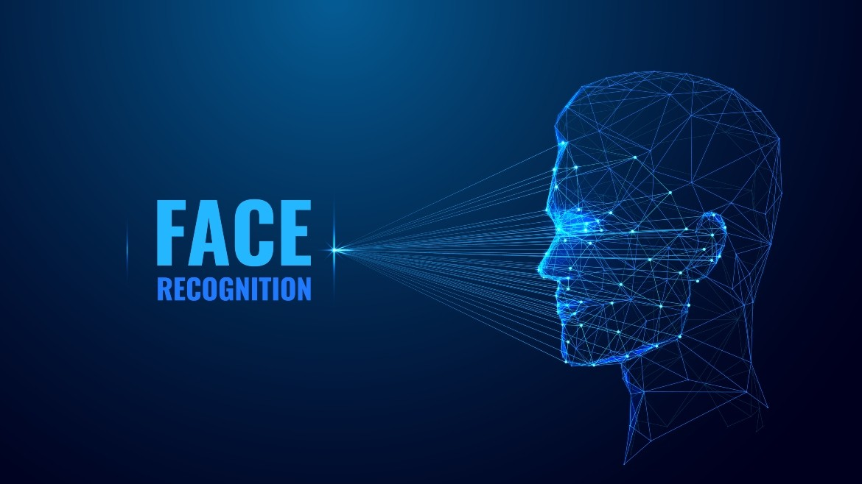
PART - 01

Slide 4
PART - 01:
EXPLORE DATSET
NEURAL NETWOERK
IMPORT LBRARIES
VISUALIZATION
RESBLOCK
COMPLIE
AUGMENTATION
NORMALIZATION
TRAIN
PERFORMANCE
ACCURACY
PLOT - GRAPH

Slide 5
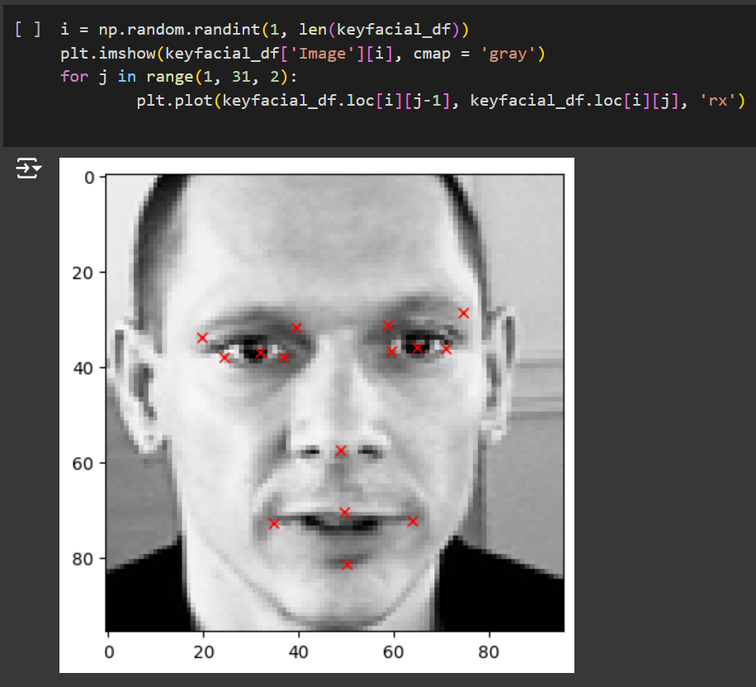
PART - 01:
FACE DETECTION IS A FUNDAMENTAL TASK IN COMPUTER VISION THAT INVOLVES LOCATING AND IDENTIFYING HUMAN FACES WITHIN DIGITAL IMAGES OR VIDEO FRAMES. THIS TECHNOLOGY SERVES AS A CORNERSTONE FOR NUMEROUS APPLICATIONS, RANGING FROM SECURITY AND SURVEILLANCE TO SOCIAL MEDIA AND AUGMENTED REALITY.

Slide 6
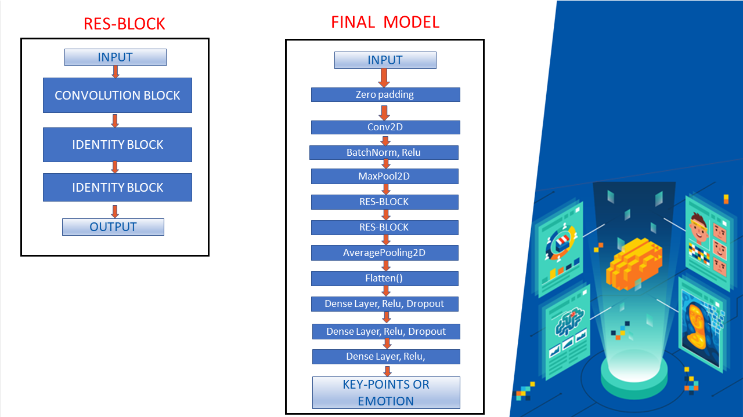
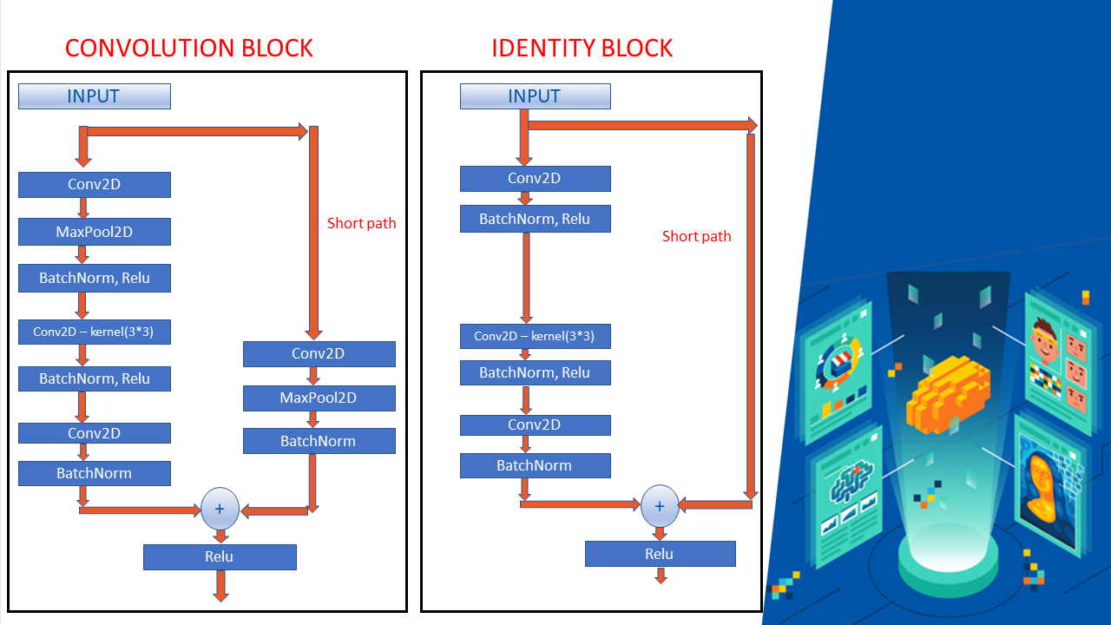
PART - 01:

Slide 7
PART - 01:
IMAGE PREPROCESSING: TECHNIQUES SUCH AS IMAGE RESIZING, NORMALIZATION, AND NOISE REDUCTION PREPARE IMAGES FOR EFFICIENT FACE DETECTION.
FEATURE EXTRACTION: ALGORITHMS ANALYZE PIXEL INTENSITIES, EDGES, TEXTURES, AND PATTERNS TO IDENTIFY POTENTIAL REGIONS OF INTEREST THAT MAY CONTAIN FACES.
FACE DETECTION ALGORITHMS:

Slide 8
PART - 01:
APPLICATIONS:
SECURITY AND SURVEILLANCE: IDENTIFYING INDIVIDUALS FOR ACCESS CONTROL AND MONITORING.
SOCIAL MEDIA AND PHOTOGRAPHY: AUTOMATICALLY TAGGING FACES IN PHOTOS AND VIDEOS.
BIOMETRICS: FACIAL RECOGNITION FOR IDENTITY VERIFICATION.
EMOTION RECOGNITION: ANALYZING FACIAL EXPRESSIONS FOR EMOTION DETECTION.
AUGMENTED REALITY: OVERLAYING DIGITAL CONTENT ON DETECTED FACES IN REAL-TIME.

Slide 9
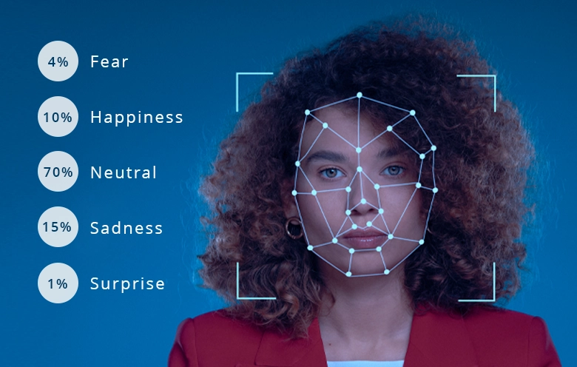
PART - 02

Slide 10
PART - 02:
EXPLORE DATSET
NEURAL NETWOERK
IMPORT LBRARIES
VISUALIZATION
RESBLOCK
COMPLIE
AUGMENTATION
PLOT
TRAIN
DEPLOY
SAVE BOTH MODELS
MAKE REQUESTS

Slide 11
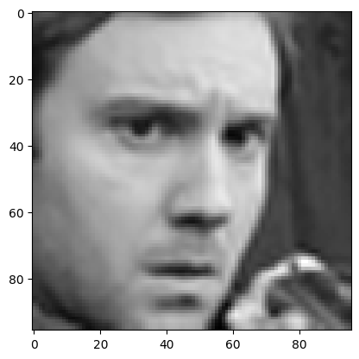
PART - 02:
EMOTION AI, ALSO KNOWN AS AFFECTIVE COMPUTING, IS A FIELD OF ARTIFICIAL INTELLIGENCE THAT FOCUSES ON UNDERSTANDING AND INTERPRETING HUMAN EMOTIONS. THIS TECHNOLOGY LEVERAGES VARIOUS TECHNIQUES FROM MACHINE LEARNING, COMPUTER VISION, NATURAL LANGUAGE PROCESSING, AND SENSOR DATA ANALYSIS TO DETECT, RECOGNIZE, AND RESPOND TO HUMAN EMOTIONS.

Slide 12
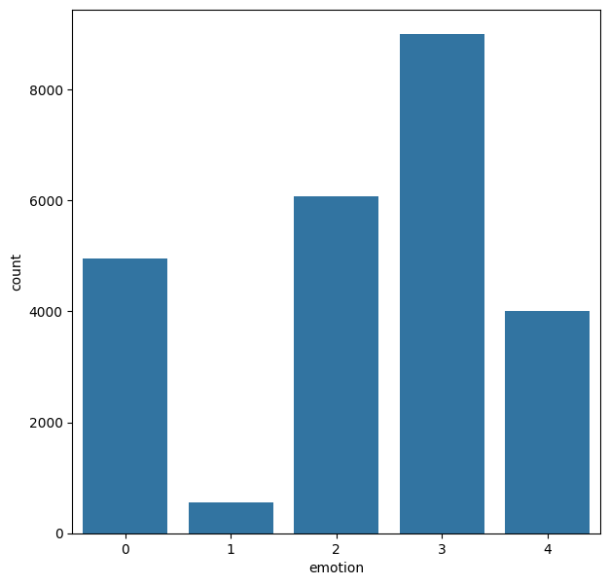
PART - 02:
DATA CONTAINS IMAGES THAT BELONG TO 5 CATEGORIES: 0 = ANGRY, 1 = DISGUST, 02 = SAD, 03 = HAPPY AND 04 = SURPRISE.
DATA OF DISGUST IS LOW SO WE NEED TO PERFORM DATA PREPARATION AND IMAGE AUGMENTATION.

Slide 13
PART - 02:
EMOTION DETECTION: ANALYSIS OF FACIAL EXPRESSIONS, VOICE TONES, GESTURES, AND PHYSIOLOGICAL SIGNALS (E.G., HEART RATE, SKIN CONDUCTANCE) TO DETECT EMOTIONS SUCH AS HAPPINESS, SADNESS, ANGER, AND SURPRISE.
DATA COLLECTION AND PROCESSING: LARGE DATASETS OF LABELED EMOTIONAL DATA ARE ESSENTIAL FOR TRAINING EMOTION AI MODELS. PREPROCESSING METHODS LIKE NORMALIZATION AND FEATURE EXTRACTION ARE USED TO PREPARE DATA FOR ANALYSIS.
MACHINE LEARNING MODELS: COMMON MODELS INCLUDE DEEP NEURAL NETWORKS, CONVOLUTIONAL NEURAL NETWORKS (CNNS), RECURRENT NEURAL NETWORKS (RNNS), AND ENSEMBLE METHODS. THESE MODELS IDENTIFY PATTERNS AND PREDICT EMOTIONS FROM INPUT DATA.

Slide 14
PART - 02:
APPLICATIONS:
HEALTHCARE: MONITORING PATIENT EMOTIONS FOR PERSONALIZED CARE.
RETAIL: ANALYZING CUSTOMER EMOTIONS TO ENHANCE SERVICE AND SALES.
EDUCATION: ASSESSING STUDENT ENGAGEMENT AND UNDERSTANDING.
ENTERTAINMENT: IMPROVING USER EXPERIENCES IN GAMES AND VIRTUAL REALITY.
AUTOMOTIVE: ENHANCING DRIVER SAFETY AND COMFORT BASED ON EMOTIONAL STATES.

Slide 15
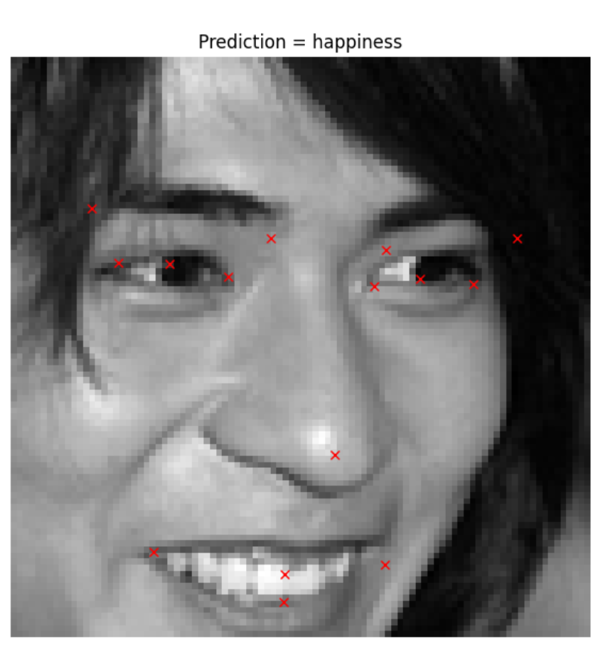
PART - 02:
EMOTION AI IS A PROMISING FRONTIER IN ARTIFICIAL INTELLIGENCE, ENHANCING HUMAN-MACHINE INTERACTIONS AND UNDERSTANDING HUMAN EMOTIONS IN NEW WAYS. AS DEVELOPMENT CONTINUES, ADDRESSING CHALLENGES AND ENSURING ETHICAL PRACTICES WILL BE CRUCIAL FOR ITS SUCCESSFUL INTEGRATION INTO SOCIETY.

Slide 16
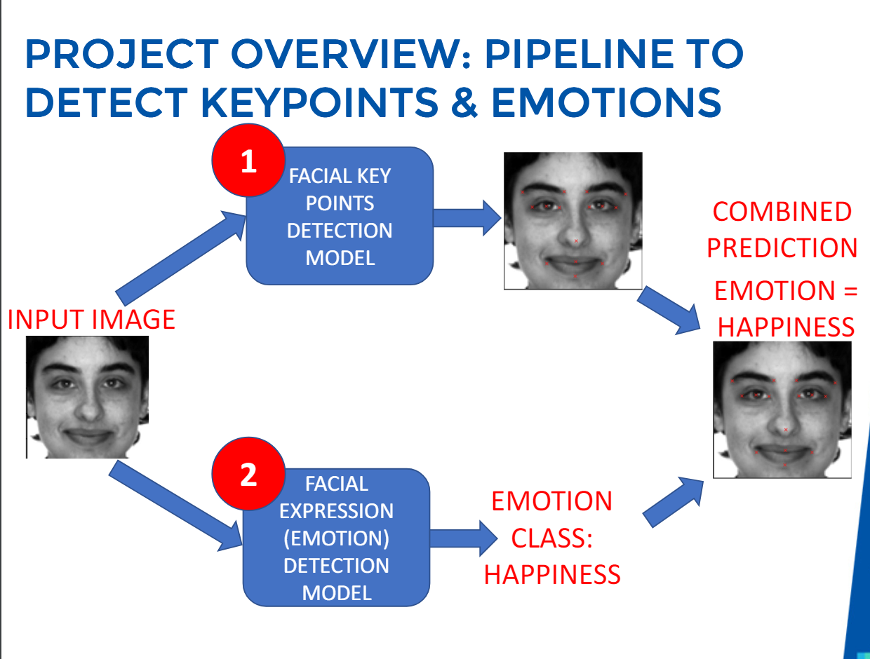

Slide 17
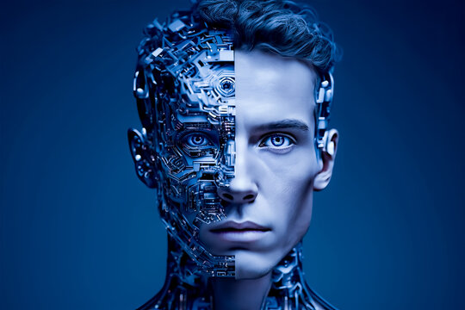
THANK YOU

